Slide 1

Refactoring
Anshu Dubey Argonne National Laboratory
Software Productivity Track, ATPESC 2020
See slide 2 for license details

Slide 2
License, Citation and Acknowledgements
License and Citation
This work is licensed under a Creative Commons Attribution 4.0 International License (CC BY 4.0).
The requested citation the overall tutorial is: David E. Bernholdt, Anshu Dubey, Mark C. Miller, Katherine M. Riley, and James M. Willenbring, Software Productivity Track, in Argonne Training Program for Extreme Scale Computing (ATPESC), August 2020, online. DOI: 10.6084/m9.figshare.12719834
Individual modules may be cited as Speaker, Module Title, in Software Productivity Track…
Acknowledgements
Additional contributors include: Patricia Grubel, Rinku Gupta, Mike Heroux, Alicia Klinvex, Jared O’Neal, David Rogers, Deborah Stevens
This work was supported by the U.S. Department of Energy Office of Science, Office of Advanced Scientific Computing Research (ASCR), and by the Exascale Computing Project (17-SC-20-SC), a collaborative effort of the U.S. Department of Energy Office of Science and the National Nuclear Security Administration.
This work was performed in part at the Argonne National Laboratory, which is managed by UChicago Argonne, LLC for the U.S. Department of Energy under Contract No. DE-AC02-06CH11357.
This work was performed in part at the Oak Ridge National Laboratory, which is managed by UT-Battelle, LLC for the U.S. Department of Energy under Contract No. DE-AC05-00OR22725.
This work was performed in part at the Lawrence Livermore National Laboratory, which is managed by Lawrence Livermore National Security, LLC for the U.S. Department of Energy under Contract No. DE-AC52-07NA27344.
This work was performed in part at Sandia National Laboratories. Sandia National Laboratories is a multi-mission laboratory managed and operated by National Technology and Engineering Solutions of Sandia, LLC., a wholly owned subsidiary of Honeywell International, Inc., for the U.S. Department of Energy’s National Nuclear Security Administration under contract DE-NA0003525.

Slide 3
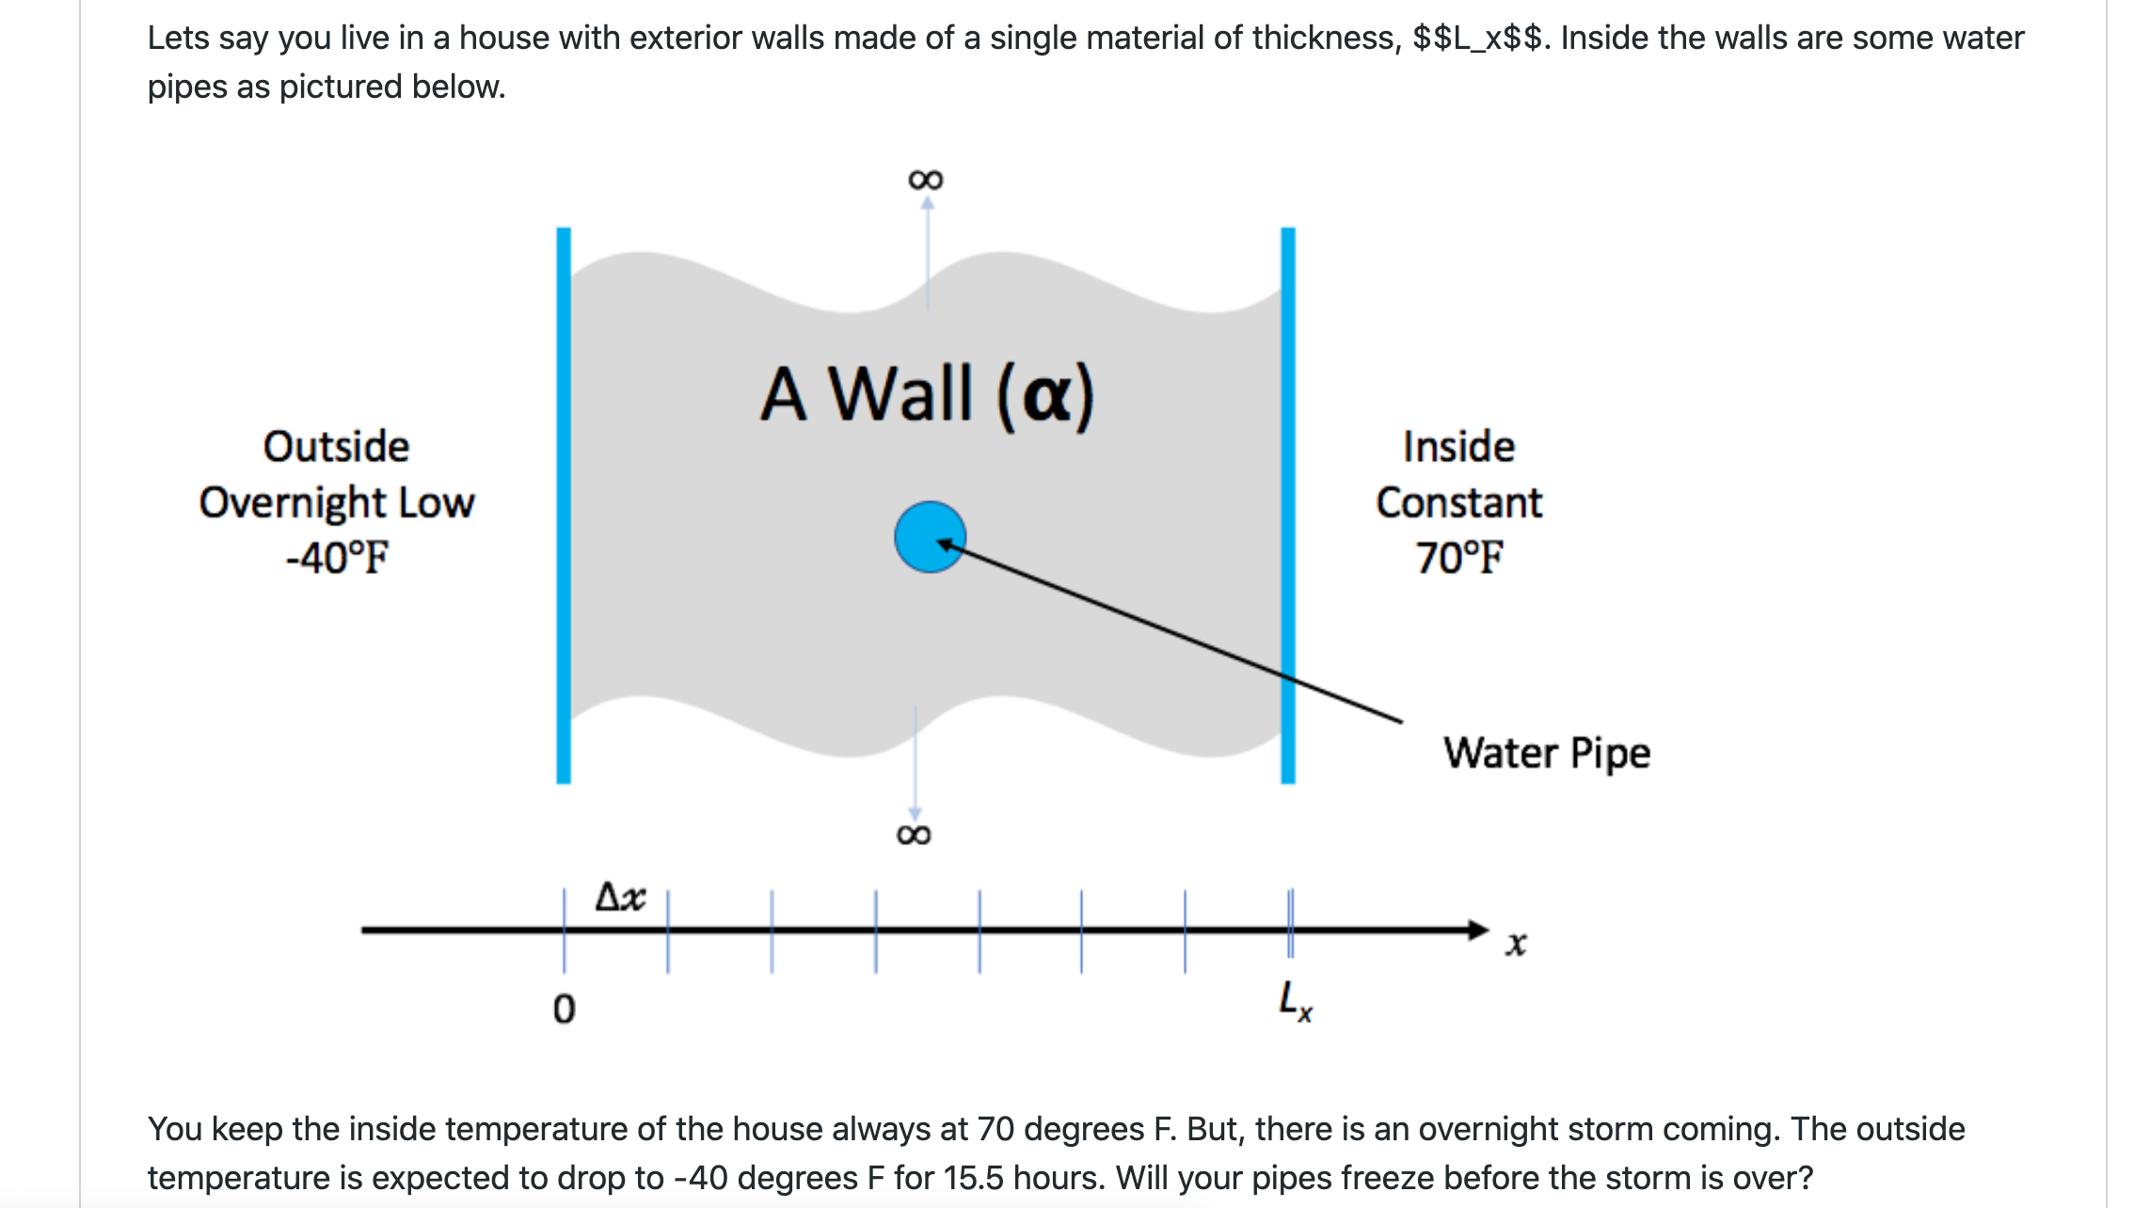
Look at the Running Example
Link to the code
https://github.com/betterscientificsoftware/hello-numerical-world-atpesc-2020/blob/main/heatAll.C
Monolithic code
Make it modular and more maintainable

Slide 4
What is Refactoring
Definition: Refactoring is a disciplined technique for restructuring an existing body of code, altering its internal structure without changing its external behavior.
Different from development
You have a working code
You know and understand the behavior
You have a baseline that you can use for comparison

Slide 5
What is Refactoring
Definition: Refactoring is a disciplined technique for restructuring an existing body of code, altering its internal structure without changing its external behavior.
Different from development
You have a working code
You know and understand the behavior
You have a baseline that you can use for comparison
General motivations
Modularity enhancement
Improve sustainability
Release to outside users
Easier to use and understand
Port to new platforms
Performance portability
Expand capabilities
Structural flexibility

Slide 6
Refactoring
An example of workflow with testing
Notes:
Tests written before refactoring encapsulate and enforce a contract made at design time. Having them available easily allows us to maintain that any small change does not alter behavior of code being refactored.
Fowler (1999) via Code Complete:
Refactoring is “a change made to the internal structure of the software to make it easier to understand and cheaper to modify without changing its behavior”.

Slide 7
Considerations for Refactoring
Know why you are refactoring
Is it necessary
Where should the code be after refactoring
In heat example
It is necessary because
It is a monolithic code
No reusability of any part of the code
Devising tests is hard
Limited extensibility
Where do we want to be after refactoring
Closer to the version that you encountered in math libraries track
More modular, maintainable and extensible

Slide 8
Considerations for Refactoring
What do we do
Separate out utilities, generalize interfaces
Separate out integration function
Make a general interface to allow alternative implementations
Create a general build function
No new code or intrusive changes
Know the scope of refactoring
How deep a change
How much code will be affected
In heat example
No capability extension
No performance consideration
Cleaner, more maintainable code

Slide 9
Before Starting
Know your cost estimates
Verification
Check for coverage provided by existing tests
Develop new tests where there are gaps
Make sure tests exist at different granularities
There should be demanding integration and system level tests
Know your bounds
on acceptable behavior change
error bounds
bitwise reproduction of results unlikely after transition
Map from here to there
Incorporate testing overheads into refactoring cost estimates

Slide 10
Cost estimation
The biggest potential pitfall
Can be costly itself if the project is large
Most projects do a terrible job of estimation
Insufficient understanding of code complexity
Insufficient provisioning for verification and obstacles
Refactoring often overruns in both time and budget
Factors that can help
Knowing the scope and sticking to it
If there is change in scope estimate again
Plan for all stages of the process with contingency factors built-in
Make provision for developing tests and other forms of verification
Can be nearly as much or more work than the code change
Insufficient verification incurs technical debt

Slide 11
Cost estimation
When development and production co-exist
Potential for branch divergence
Policies for code modification
Estimate the cost of synchronization
Plan synchronization schedule and account for overheads
Anticipate production disruption
From code freeze due to merges
Account for resources for quick resolution of merge issues
This is where buy-in from the stake-holders is critical
In the heat example
No more than a few hours of developer time
No disruption
No need for a buy-in

Slide 12
How do we determine what other tests are needed?
Code coverage tools
Expose parts of the code that aren’t being tested
gcov - standard utility with the GNU compiler collection suite (we will use it in the next few slides)
Compile/link with –coverage & turn off optimization
counts the number of times each statement is executed
gcov also works for C and Fortran
Other tools exist for other languages
JCov for Java
Coverage.py for python
Devel::Cover for perl
profile for MATLAB
Lcov
a graphical front-end for gcov
available at http://ltp.sourceforge.net/coverage/lcov.php
Codecov.io in CI module
Hosted servers (e.g. coveralls, codecov)
graphical visualization of results
push results to server through continuous integration server
Interoperability coverage may need something like the matrix in testing module

Slide 13
Exercise: Refactoring the Running Example
Convert heatAll.C to the cleaner version with reusable code.
Though a solution exists and has been given to you your solution need not be identical
Think about how you want your final product to be and then go through the exercise of refactoring
Here I am taking the clean solution that Mark wrote and generalizing the update_solution interface
Motivation: Do not want to change heat.C for adding another method
For this exercise we will use “ftcs” and “upwind15” as alternative options

Slide 14
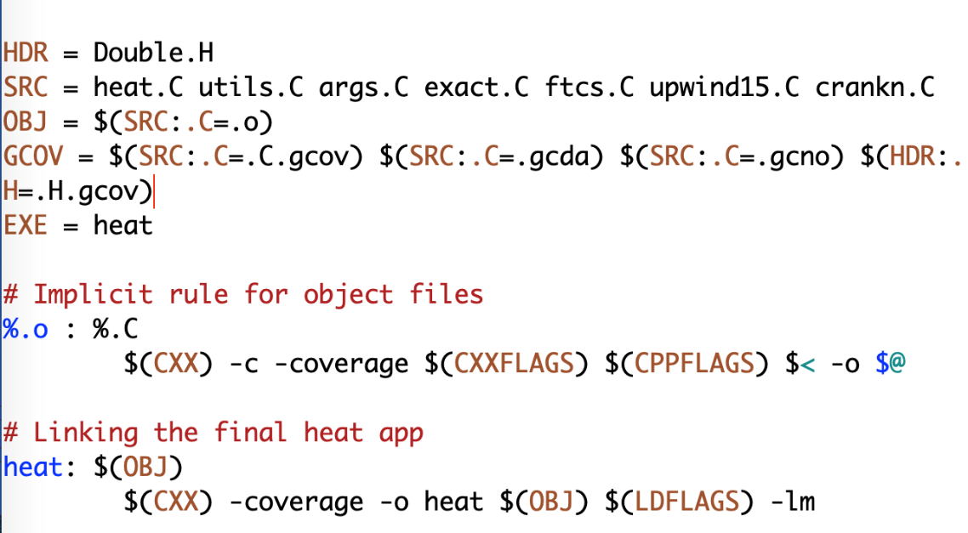
Preparing for Refactoring – check coverage
In your working copy add -coverage as shown below
Run ./heat runame=“ftcs_results”
Run gcov heat.C
Examine heat.C.gcov

Slide 15
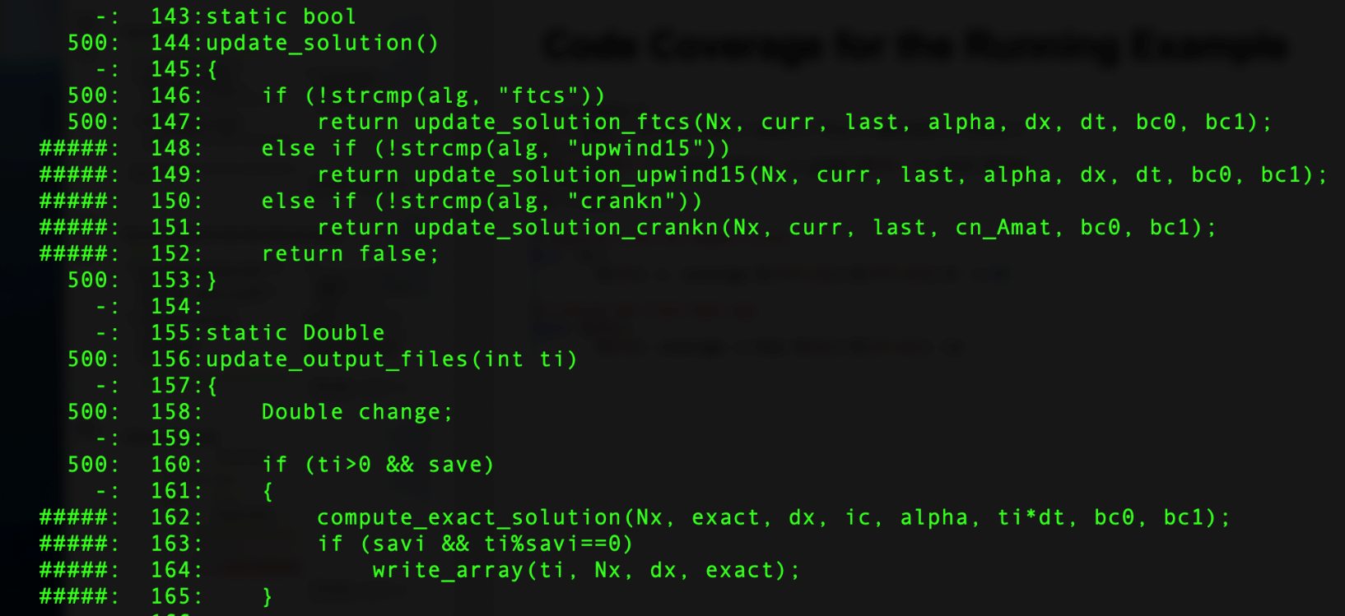
Preparing for Refactoring – check coverage
In your working copy add -coverage as shown below
Run ./heat runame=“ftcs_results”
Run gcov heat.C
Examine heat.C.gcov
A dash indicates non-executable line
A number indicated the times the line was called
##### indicates line wasn’t exercised

Slide 16
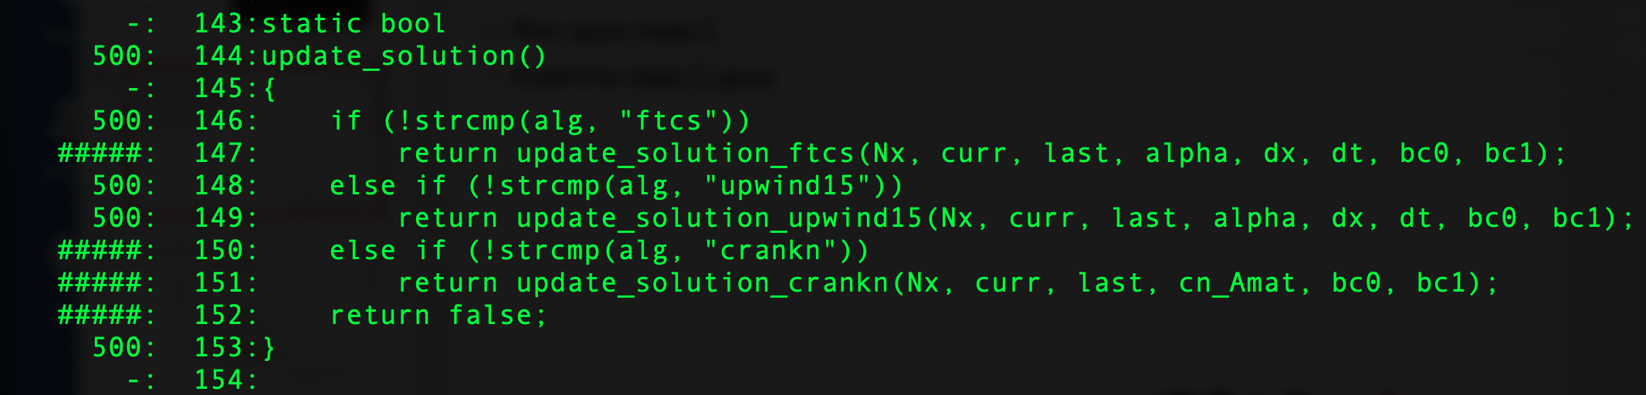
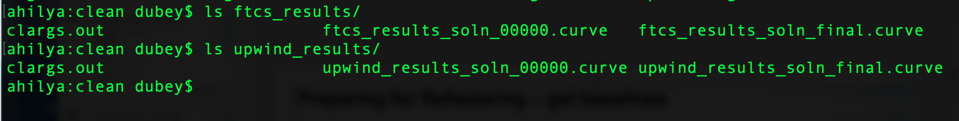
Preparing for Refactoring – get baselines
Call to upwind15 not exercised
Run ./heat alg=“upwind15” runame=“upwind_results
We have baselines for ftcs and upwind

Slide 17
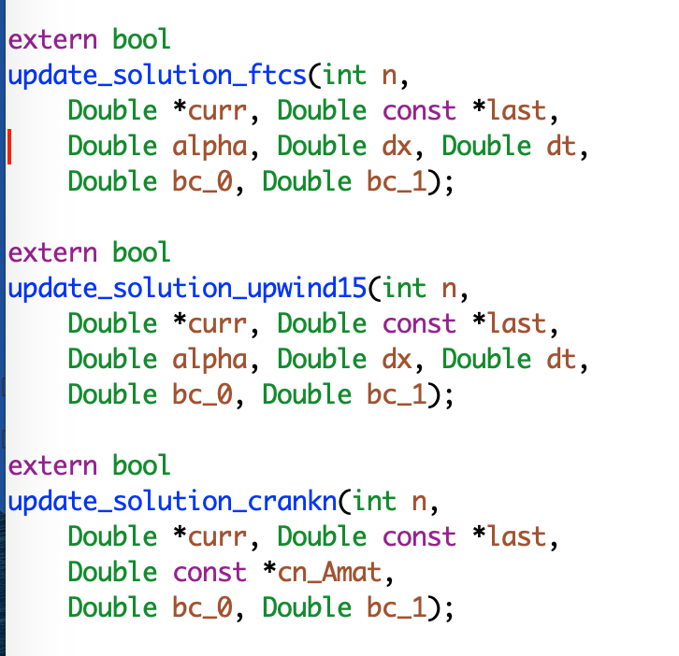
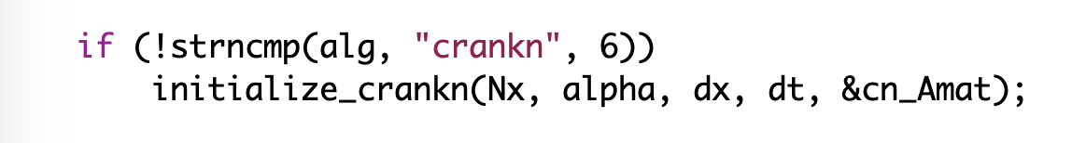
Refactoring – The starting code
Interfaces are not identical
crankn has an extra argument
It also has an extra step in initialization

Slide 18
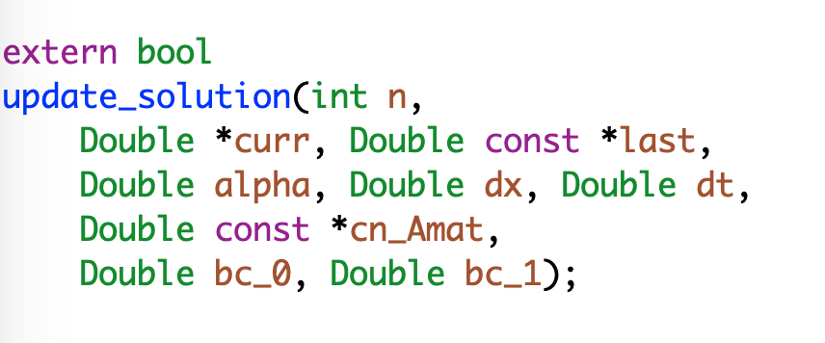
Refactoring
Generalize the interface
Modify the makefile

Slide 19
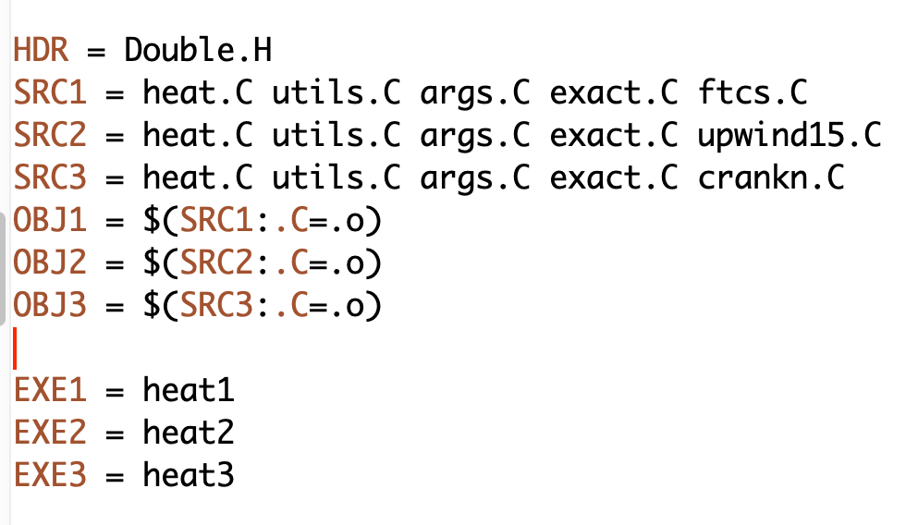
Refactoring
Generalize the interface
Modify the makefile

Slide 20
Refactoring
Generalize the interface
Modify the makefile
Add null implementations of initialize_crank in ftcs and upwind15

Slide 21
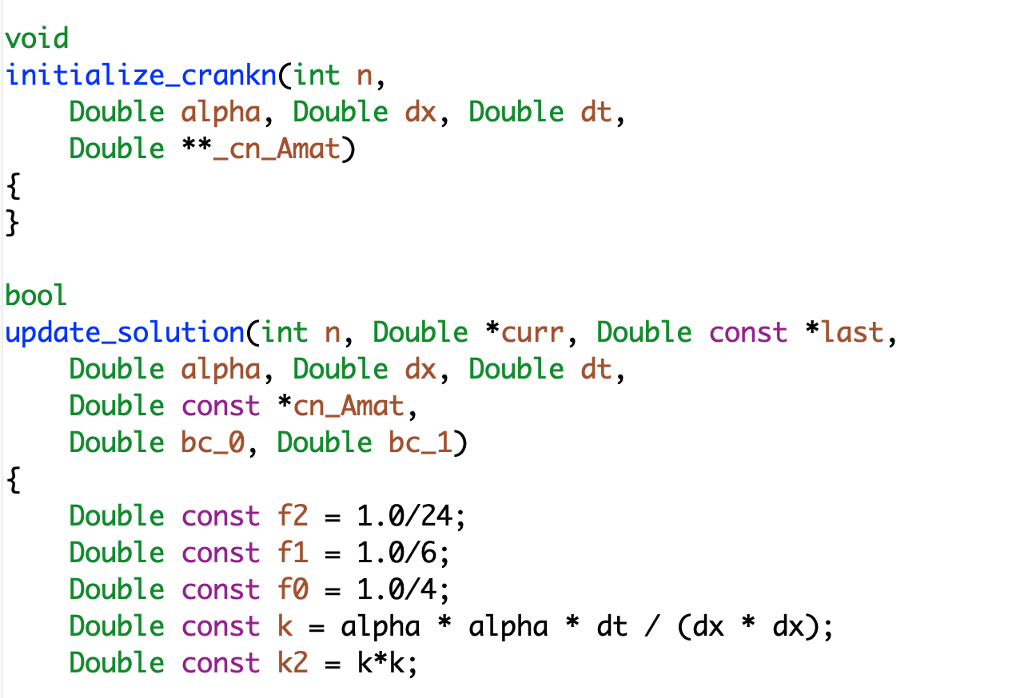
Refactoring
make heat1
Run ./heat runame=“ftcs_results”
Make heat2
Run ./heat runame=“upwind_results”
Verify against baseline

Slide 22
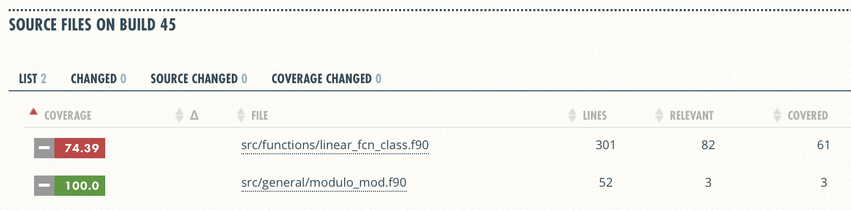
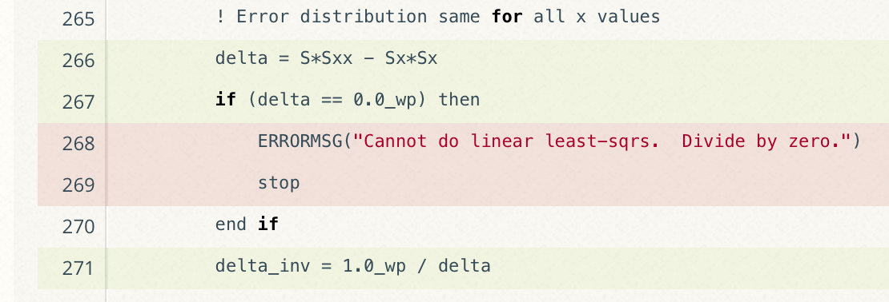
Graphical View of Gcov Output and Tutorials for Code Coverage
Overall Analysis
Detailed Analysis
Online tutorial - https://github.com/amklinv/morpheus
Other example - https://github.com/jrdoneal/infrastructure
Notes:
Missing testing of edge cases. This might be important!

Slide 23
More Realistic Example From FLASH
Grid
Manages data
Domain discretization
Physics
Several solvers
Driver
Time-stepping
Orchestrates interactions
Notes:
Highlight that simpleUnsplit and Unsplit are two different, but similar implementations. One is fully-featured and the other is lightweight and simple. This makes the latter useful for development and debugging. These two are mentioned later in the talk.

Slide 24
More Realistic Example From FLASH
Goal: Replace Paramesh with AMReX
Changes and new
implementation

Slide 25
Considerations
In FLASH
Initial estimate at 6-12 months
Took close to 12 months
Cost estimation
Expected developer time
Extent of disruption in production schedules
Get a buy-in from the stakeholders
That includes the users
For both development time and disruption

Slide 26
FLASH5
Refactoring for Next Generation Hardware
AMReX - Lawrence Berkeley National Lab
Designed for exascale
Node-level heterogeneity
Smart iterators hide parallelization
Goal: Replace Paramesh with AMReX
Plan: Getting there from here
On ramping
Design
Intermediate steps
Realizing the goal
Notes:
Can point out that this graphic show the need to update the tree - two AMR implementations required a new AMR subfolder.

Slide 27
Map from Here to There: On ramp plan
Proportionate to the scope
Scattered independent changes - May be OK
All at once
Invasive large-scale change in the code - Bad idea
All at once

Slide 28
On ramp plan
So how should it be done
Incrementally if at all possible
Small components, verified individually
Migrated back, integration tests done
Alternatively migrate them into new infrastructure

Slide 29
Map From Here to There
Paramesh & AMReX coexist
Adapt interfaces to suit AMReX
Refactor Paramesh implementation
Compare AMReX implementation against Paramesh implementation

Slide 30
Refactoring plan
Design
Degree & scope of change
Formulate initial requirements
Prototyping
Explore & test design decisions
Update requirements
Implementation
Recover from prototyping
Expand & implement design decisions

Slide 31
Phase 1 - design
Sit, think, hypothesize, & argue
Derive and understand principal definitions & abstractions
Collect & understand Paramesh/AMReX constraints
Generally useful design due to two sets of constraints?
Collect & understand physics unit requirements on Grid unit
Design fundamental data structures & update interface
Notes:
Paramesh/AMReX constraints inform what we can implement and therefore offer clients through the interface.
The coupling to Hydro explains what is needed from Grid and how it must be requested.
The point is that we are looking at both sides of the interface to determine what shape it can tak

Slide 32
Phase 2 - prototyping
Quick, dirty, & light
Implement new data structures
Evolve design/implementation by iterating between Paramesh & AMReX
Explore Grid/physics unit interface
simpleUnsplit Hydro unit
A simplified implementation
No need to be physically correct
Exercise the grid interface identically to the real solver
Discover use patterns of data structures and Grid unit interface
Adjust requirements & interfaces
Notes:
Prototyping is a first level stress testing of our design decisions and interface. To be an effective stress test, we should have likely expanded further out to capture more use cases of our interface. That said, Klaus and Anshu are already aware of these use cases and could have known that the limited scope of this phase was reasonably stressful and therefore informative.
Implementing with Hydro let us discover common usage patterns to build a gut-level understanding of whether or not the interface was a natural fit for the application.

Slide 33
Phase 3 - implementation
Toward quantifiable success & Continuous Integration
Derive & implement lessons learned
Clean code & inline documentation
Update Unsplit Hydro
Hybrid FLASH
AMReX manages data
Paramesh drives AMR
Fully-functioning simulation with AMReX
Prune old code
Notes:
Point of hybrid method was first and foremost to build a proof of concept that worked on system-level tests. It was also a means to test out the design decisions and the efficiency of the associated implementations at a larger grained level. This is in contrast to the forward engineering being done by me at the level of routines, units, and unittests.
Adding new features or capabilities grew test suite.s

Slide 34
Important Takeaways
Procedures and policies
Developers should know what the end code should be
They will do the code implementation
You may need to develop some possibly throwaway code
Often that ends up being useful in unexpected ways
Process and policies are important
Managing branch divergence
Any code pruning
Schedule of testing
Schedule of integration and release
Release may be external or just to the internal users

Slide 35
Other resources
Software testing levels and definitions:
http://www.tutorialspoint.com/software_testing/software_testing_levels.htm
Working Effectively with Legacy Code, Michael Feathers.
The legacy software change algorithm described in this book is very straight-forward and powerful for anyone working on a code that has insufficient testing.
Code Complete, Steve McConnell. Includes testing advice.
Software Carpentry: http://katyhuff.github.io/python-testing/
Tutorial from Udacity: https://www.udacity.com/course/software-testing--cs258
Papers on testing:
http://www.sciencedirect.com/science/article/pii/S0950584914001232
https://www.researchgate.net/publication/264697060_Ongoing_verification_of_a_multiphysics_community_code_FLASH
Resources for Trilinos testing:
Trilinos testing policy: https://github.com/trilinos/Trilinos/wiki/Trilinos-Testing-Policy
Trilinos test harness: https://github.com/trilinos/Trilinos/wiki/Policies--%7C-Testing

Slide 36
To have good outcome from refactoring
Know why
Know how much
Know the cost
Plan
Have strong testing and verification
Get buy-in from stakeholders

Slide 37
Agenda
Time (Central TZ) | Module | Topic | Speaker
9:30am-9:45am | 00 | Introduction | David E. Bernholdt, ORNL
9:45am-10:15am | 01 | Overview of Best Practices in HPC Software Development | Katherine M. Riley, ANL
10:15am-10:45am | 02 | Agile Methodologies | James M. Willenbring, SNL
10:45am-11:00am | 03 | Git Workflows | James M. Willenbring, SNL
11:00am-11:15am |  | Break (and Q&A with speakers)
11:15am-12:00pm | 04 | Software Design | Anshu Dubey, ANL
12:00pm-12:45pm | 05 | Software Testing | Anshu Dubey, ANL
12:45pm-1:45pm |  | Lunch (and Q&A with speakers)
1:45pm-2:00pm | 06 | Agile Methodologies Redux | James M. Willenbing, SNL
2:00pm-3:00pm | 07 | Refactoring | Anshu Dubey, ANL
3:00pm-3:15pm |  | Break (and Q&A with speakers)
3:15pm-3:45pm | 08 | Continuous Integration | Mark C. Miller, LLNL
3:45pm-4:30pm | 09 | Reproducibility | David E. Bernholdt, ORNL
4:30pm-4:45pm | 10 | Summary | David E. Bernholdt, ORNL

